Slide 1
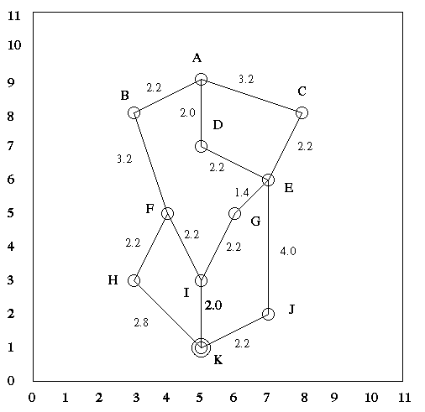
A* Practice Assignment
Find optimal path from ‘A’ to ‘K’
Course & Batch : _________________________
Roll No: __________________________________
Name: _________________________________
Date of submission:_______________________
Node Coordinates SL Distance to K
A (5,9) 8.0
B (3,8) 7.3
C (8,8) 7.6
D (5,7) 6.0
E (7,6) 5.4
F (4,5) 4.1
G (6,5) 4.1
H (3,3) 2.8
I (5,3) 2.0
J (7,2) 2.2
K (5,1) 0.0
Answer to include
Optimal Path
Open and close list
g(n) : cost to reach the node
h(n) : cost to get to the goal
And f(n) = g(n) + h(n), : estimated cost of the cheapest solution

